Slide 1
Cleaning of the EEG electrodes

Slide 2
Cleaning the Electrodes of EEG device
The quality of the signal acquired by the device depends on the degree of contact of the electrodes with the device.
Since we apply saline solution to the felt in the EEG device , it causes corrosion in the electrodes , since the electrodes are merely metals .
Some of the impurities formed are Copper Sulphate , since the electrodes are coated with Copper metal.

Slide 3
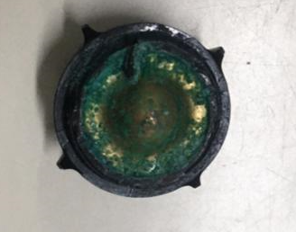
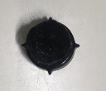
Step 1 : Taking the electrode from the EEG device
The felt ( the black spongy material ) which makes a contact between the measuring electrode and the surface of skin
The electrode which connects the felt and the device
From the images , we observer that the electrode has some salt deposited on it. The possible reason is the formation of Copper sulfate salt on the electrode’s surface

Slide 4
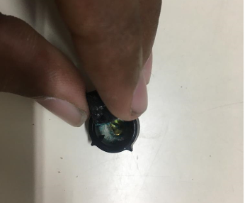
Step 2 : Dismantling the Electrode Setup
Gently remove the felt from its position

Slide 5

Step 2 : Dismantling the Electrode Setup
From the image , it can be seen that the electrode ( measuring electrode ) has been contaminated on both its sides ( inner and outer )

Slide 6
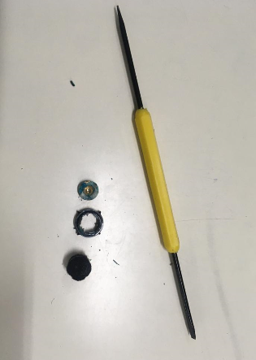
Step 2 : Dismantling the Electrode Setup
With the help of a sharp object ( in this case , a screw driver ) , gently poke the inner side of the electrode until the electrode pops out from its place .
In the above image the measuring electrode , the frame and the felt are shown ( images are from left to right order )

Slide 7
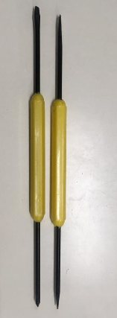

Step 3 : Scraping off the impurities from the electrode
To scrape off the impurities from the electrode , we use screw drivers or picks .
Gently scrape off the impurities as we don’t want to damage the surface of the electrode.

Slide 8
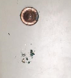
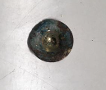
Step 3 : Scrapping off the impurities from the electrode
The electrode has been scraped of the impurities
The impurities which have been removed can be seen to the right of the electrode

Slide 9
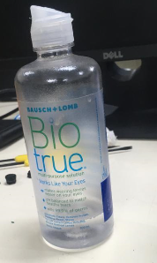
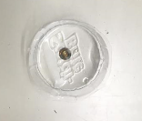
Step 4 : Removing Excess Impurities
Sometimes , the impurities cannot be remove easily . Hence , in such cases , we immerse the electrode in a saline solution ( example : Biotrue solution ) for 5 – 10 minutes . Now , the impurities soften up and so we can remove them quickly.
Electrode Soaking In Saline Solution
BioTrue Solution

Slide 10
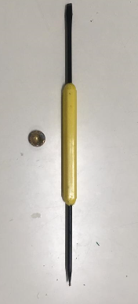
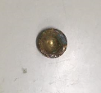

Step 4 : Removing Excess Impurities
Now , take out the electrode from the saline solution and then scrape the impurities from the electrode.
Before
After

Slide 11

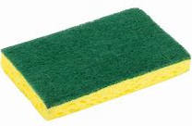
Step 4 : Removing Excess Impurities
Dip the electrode in a saline solution just or soak the electrode.
Just let the electrode to soak for sometime ( about 5 – 10 mins.)
Now take out the electrode and rub it against
a hard surface ( example : scrubber )
This step is used for perfect removal of impurities from the electrode surface.

Slide 12
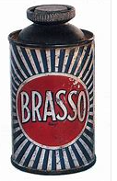
Step 5 : Polishing the surface
The surface of the electrode is then polished with some Brasso or some other polishing material .
Need for polishing :
To have smooth finish on the layer of the electrode
To make contact perfect
Polishers may contain chemicals which may improve lifetime of the electrodes.

Slide 13
Storage of Electrodes
Storage of the electrodes is essential because , when left outside the metal plating of the electrodes get corroded.
The outer contact of the electrode gets dried up. It needs some moisture for the signal to be accurate.
The electrodes are placed in a sealed box, this is done to prevent oxidation of the metal contacts.
The electrodes can also be stored in alcohol or saline water which would prevent the surface of the electrode from oxidation.
The felts are well washed after use ( as the saline solution in the felt would cause the felt to harden and eventually break apart when force is applied on it) and then dried and then stored in a well packed box.

